Slide 1
DATABASE MANAGEMENT SYSTEM (DBMS)

Slide 2
Course Outcomes
CO1: Describe Database systems, various Data models and Database
architecture
C02: Develop various real time applications using Relational
algebra and Relational calculus
CO3: Apply various Normalization techniques to refine schema
CO4 : Explain Transaction management and Concurrency Control
CO5: Illustrate various Database indexing techniques

Slide 3
Unit – I
An Overview of Database Systems: Managing data, File systems verses DBMS, Advantages of DBMS, Data models, Levels of abstraction in a DBMS, Data independence, Structure of a DBMS, Client/Server Architecture, E.F. Codd Rules. Database Design: Database design and ER Diagrams, Entities, Attributes, Entity sets, Relationships and Relationship sets, Conceptual design with ER Models.

Slide 4
Database Management System
UNIT – I : An overview of Database System & Database Design
UNIT – II : Relational Model
UNIT – III : SQL Queries , Constraints and Triggers. Normalization.
UNIT – IV : Transaction Management & Concurrency Control
UNIT – V : Storage and Indexing

Slide 5
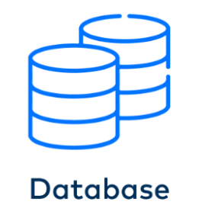
UNIT - I
Managing Data
Data : Data is a collection of raw facts, such as rollno, empno, studname etc.,
Database : A database is an organized collection
of data, so that it can be easily accessed and managed.
Database Management System(DBMS) : It is a software system
that is designed to manage and organize data in structure manner. It is a collection of databases.

Slide 6
File System VS DBMS
Basis | File System | Database System
Structure | The file system is a way of arranging the files in a storage medium within a computer. | DBMS is software for managing the database.
Data Redundancy | Redundant data can be present in a file system. | In DBMS there is no redundant data.
Backup and Recovery | It doesn’t provide backup and recovery of data if it is lost. | It provides backup and recovery of data even if it is lost.
Query Processing | There is no efficient query processing in the file system. | Efficient query processing is there in DBMS.

Slide 7
File System VS DBMS
Basis | File System | Database System
Consistency | There is less data consistency in the file system. | There is more data consistency because of the process of normalization.
Complexity | It is less complex as compared to DBMS. | It has more complexity in handling as compared to the file system.
Security Constraints | File systems provide less security in comparison to DBMS. | DBMS has more security mechanisms as compared to file systems.
Cost | It is less expensive than DBMS. | It has a comparatively higher cost than a file system.
Data Independance | There is no data independence. | In DBMS data independence exists.

Slide 8
File System VS DBMS
Basis | File System | Database System
User Access | Only one user can access data at a time. | Multiple users can access data at a time.
Sharing | Data is distributed in many files. So, not easy to share data | Due to centralized nature sharing is easy
Data Abstraction | It give details of storage and representation of data | It hides the internal details of Database
Integrity Constraints | Integrity Constraints are difficult to implement | Integrity constraints are easy to implement
Examples | Cobol, C++ | Oracle, MySql

Slide 9
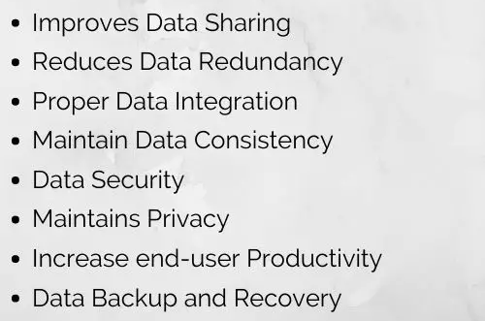
Advantages of DBMS

Slide 10
DATA MODELS
Data Model : Data models are used to describe how the data is stored, accessed, and updated in a DBMS. Data models describe how a database's logical structure is represented. In a database management system, data models are essential for introducing abstraction. Data models specify how data is linked to one another, as well as how it is handled and stored within the system.
Types of Data Models in DBMS
Hierarchical Model.
Network Model. ...
Entity-Relationship Model. ...
Relational Model. ...
Object-Oriented Data Model. ...

Slide 11
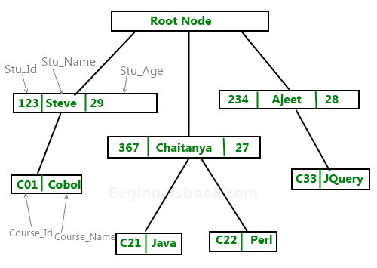
HIERARCHICAL DATA MODEL
In a hierarchical model, data are viewed as a collection of tables, or we can say segments that form a hierarchical relation. In this, the data is organized into a tree-like structure where each record consists of one parent record and many children.

Slide 12
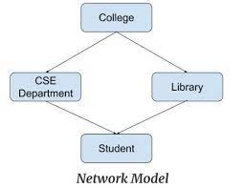
NETWORK DATA MODEL
In DBMS, a network model is a way of organizing data in which multiple many-to-many relationships between records are represented using a graph-like structure. In this model, records are represented as nodes in the graph, and relationships between records are represented as edges connecting the nodes.

Slide 13
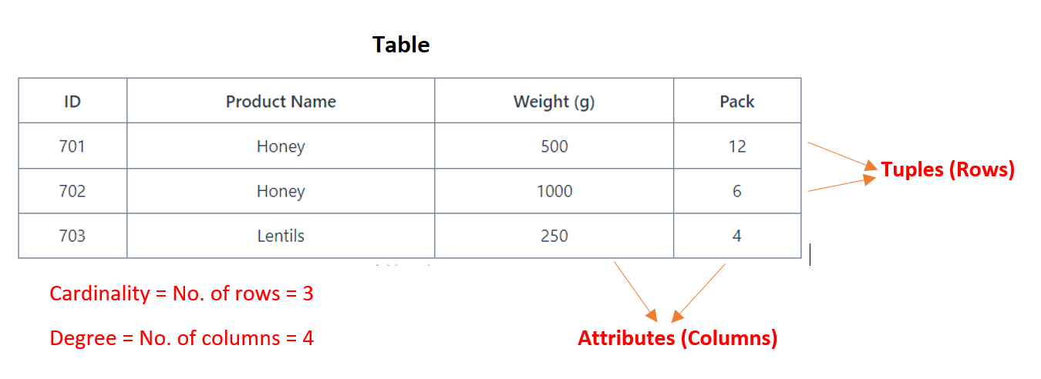
RELATIONAL DATA MODEL
The relational model for database management is an approach to logically represent and manage the data stored in a database. In this model, the data is organized into a collection of two-dimensional inter-related tables, also known as relations. Each relation is a collection of columns and rows, where the column represents the attributes of an entity and the rows (or tuples) represents the records.

Slide 14
Properties of Relation
Properties of Relations :
Name of the relation is distinct from all other relations.
Each relation cell contains exactly one atomic (single) value
Each attribute contains a distinct name
Attribute domain has no significance
Tuple has no duplicate value
Order of tuple can have a different sequence

Slide 15
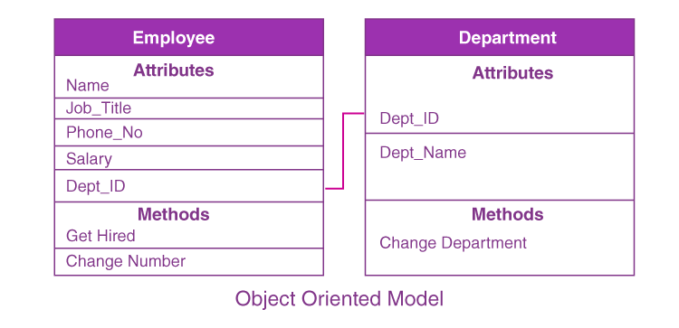
Object Oriented Data Model
The OODM is a better representation of real-world challenges. Both the data and the relationship are contained into a single structure that’s known as an object in this model. We can now store audios, pictures, videos, and other types of data in databases, which was previously impossible with the relational approach.

Slide 16
Entity-Relationship (ER) Model
It is based on the notion of real-world entities and relationships among them. While formulating real-world scenario into the database model, the ER Model creates entity set, relationship set, general attributes and constraints.
ER Model is best used for the conceptual design of a database.
ER Model is based on −
Entities and their attributes.
Relationships among entities.

Slide 17
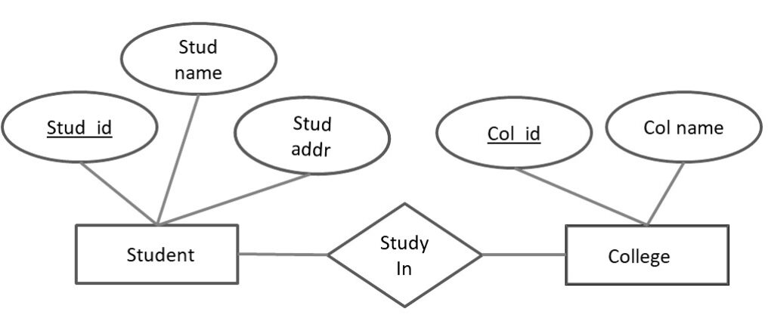
Entity − An entity in an ER Model is a real-world entity having properties called attributes.
Every attribute is defined by its set of values called domain.
For example, in a school database, a student is considered as an entity.
Student has various attributes like name, age, class, etc.
Relationship − The logical association among entities is called relationship.
Relationships are mapped with entities in various ways. Mapping cardinalities define the number of association between two entities. Mapping cardinalities are one to one, one to many, many to one and many to many.

Slide 18
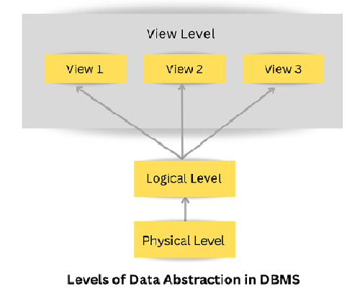
Levels of Abstraction
Database systems include complex data-structures. In terms of retrieval of data, reduce complexity in terms of usability of users and in order to make the system efficient, developers use levels of abstraction that hide irrelevant details from the users. Levels of abstraction simplify database design.
Mainly there are three levels
of abstraction for DBMS,
which are as follows −
Physical or Internal Level
Logical or Conceptual Level
View or External Level

Slide 19
View level can be used by all users (all levels' users). This level is the least complex and easy to understand.
Logical or Conceptual Level
Logical level is the intermediate level or next higher level. It describes what data is stored in the database and what relationship exists among those data. It tries to describe the entire or whole data because it describes what tables to be created and what are the links among those tables that are created.
Physical or Internal Level
It is the lowest level of abstraction for DBMS which defines how the data is actually stored, it defines data-structures to store data and access methods used by the database. Actually, it is decided by developers or database application programmers how to store the data in the database.

Slide 20
Data Independence
Data independence refers characteristic of being able to modify the schema at one level of the database system without altering the schema at the next higher level.
There are two types of data independence:
1. Logical Data Independence
Logical data independence refers characteristic of being able to change the conceptual schema without having to change the external schema.
Logical data independence is used to separate the external level from the conceptual view.
If we do any changes in the conceptual view of the data, then the user view of the data would not be affected.

Slide 21
Physical Data Independence:
Physical data independence can be defined as the capacity to change the internal schema without having to change the conceptual schema.
If we do any changes in the storage size of the database system server, then the Conceptual structure of the database will not be affected.
Physical data independence is used to separate conceptual levels from the internal levels.

Slide 22
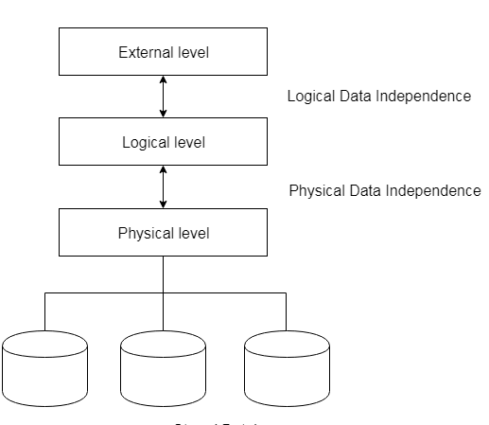
Data Independence

Slide 23
Structure of DBMS
Structure of DBMS : Database Management System (DBMS) is software that allows access to data stored in a database and provides an easy and effective method of
Defining the information.
Storing the information.
Manipulating the information.
Protecting the information from system crashes or data theft.
Differentiating access permissions for different users.
Three Parts that make up the Database System are:
Query Processor
Storage Manager
Disk Storage

Slide 24
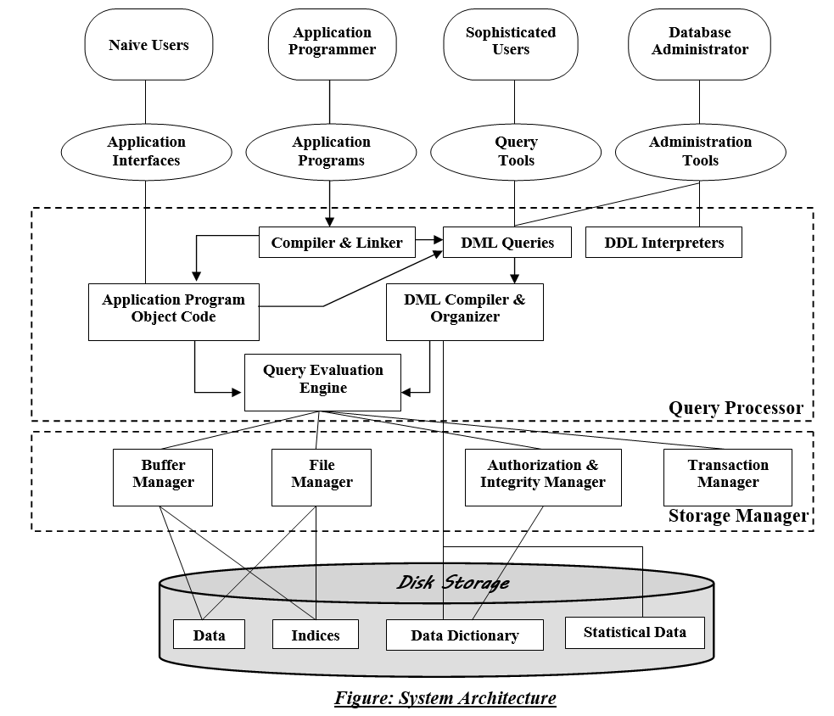

Slide 25
1. Query Processor: The query processor's primary duty is to successfully execute the query. The Query Processor transforms (or interprets) the user's application program-provided requests into instructions that a computer can understand.
Components of the Query Processor:
DML Compiler: It processes the DML statements into low level instruction (machine language), so that they can be executed.
DDL Interpreter: It processes the DDL statements into a set of table containing meta data (data about data).
Embedded DML Pre-compiler: It processes DML statements embedded in an application program into procedural calls.
Query Optimizer: It executes the instruction generated by DML Compiler.

Slide 26
2. Storage Manager: Storage Manager is a program that provides an interface between the data stored in the database and the queries received. It is also known as Database Control System. It maintains the consistency and integrity of the database by applying the constraints and executing the DCL statements. It is responsible for updating, storing, deleting, and retrieving data in the database. It contains the following components –
Authorization Manager: It ensures role-based access control, i.e,. checks whether the particular person is privileged to perform the requested operation or not. Integrity Manager: It checks the integrity constraints when the database is modified. Transaction Manager: It controls concurrent access by performing the operations in a scheduled way that it receives the transaction. Thus, it ensures that the database remains in the consistent state before and after the execution of a transaction. File Manager: It manages the file space and the data structure used to represent information in the database. Buffer Manager: It is responsible for cache memory and the transfer of data between the secondary storage and main memory.

Slide 27
3. Disk Storage: It contains the following components –
Data Files: It stores the data.
Data Dictionary: It contains the information about the structure of any database object. It is the repository of information that governs the metadata(data about data).
Indices: It provides faster retrieval of data item.
Statistical Data stores the statistical information regarding the data stored in the database. Query processor utilizes this statistical information for selecting a much more efficient way to execute a query.

Slide 28
Client-Server Architecture
DBMS Architecture
The DBMS design depends upon its architecture. The basic client/server architecture is used to deal with a large number of PCs, web servers, database servers and other components that are connected with networks.
The client/server architecture consists of many PCs and a workstation which are connected via the network.
DBMS architecture depends upon how users are connected to the database to get their request done.
Types of DBMS Architecture
Database architecture can be seen as a single tier or multi-tier. But logically, database architecture is of two types like: 2-tier architecture and 3-tier architecture.

Slide 29
1-Tier Architecture
In this architecture, the database is directly available to the user. It means the user can directly sit on the DBMS and uses it.
Any changes done here will directly be done on the database itself. It doesn't provide a handy tool for end users.
The 1-Tier architecture is used for development of the local application, where programmers can directly communicate with the database for the quick response.

Slide 30
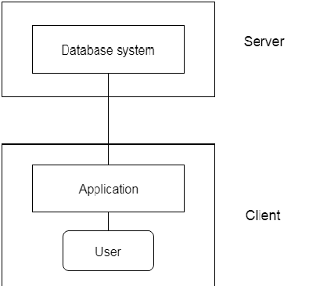
2-Tier Architecture
The 2-Tier architecture is same as basic client-server. In the two-tier architecture, applications on the client end can directly communicate with the database at the server side. For this interaction, API's like: ODBC, JDBC are used.
The user interfaces and application programs are run on the client-side.
The server side is responsible to
provide the functionalities like:
query processing and transaction management.
To communicate with the DBMS,
client-side application establishes a
connection with the server side.

Slide 31
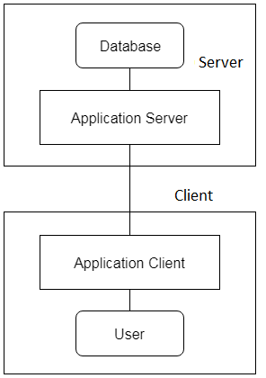
3-Tier Architecture
The 3-Tier architecture contains another layer between the client and server. In this architecture, client can't directly communicate with the server.
The application on the client-end interacts with an application server which further communicates with the
database system.
End user has no idea about the existence
of the database beyond the application server.
The database also has no idea about any
other user beyond the application.
The 3-Tier architecture is used in case of
large web application

Slide 32
E F Codd Rules
Rule 0 − Foundation rule
Any relational database management system that is propounded to be RDBMS or advocated to be a RDBMS should be able to manage the stored data in its entirety through its relational capabilities.
Rule 1 − Rule of Information
Relational Databases should store the data in the form of relations. Tables are relations in Relational Database Management Systems. Be it any user defined data or meta-data, it is important to store the value as an entity in the table cells.
Rule 2 − Rule of Guaranteed Access
The use of pointers to access data logically is strictly forbidden. Every data entity which is atomic in nature should be accessed logically by using a right combination of the name of table, primary key represented by a specific row value and column name represented by attribute value.
Rule 3 − Rule of Systematic Null Value Support
Null values are completely supported in relational databases. They should be uniformly considered as ‘missing information’. Null values are independent of any data type. They should not be mistaken for blanks or zeroes or empty strings. Null values can also be interpreted as ‘inapplicable data’ or ‘unknown information.’

Slide 33
Rule 4 − Rule of Active and online relational Catalog
In the Database Management Systems lexicon, ‘metadata’ is the data about the database or the data about the data. The active online catalog that stores the metadata is called ‘Data dictionary’. The so called data dictionary is accessible only by authored users who have the required privileges and the query languages used for accessing the database should be used for accessing the data of data dictionary.
Rule 5 − Rule of Comprehensive Data Sub-language
A single robust language should be able to define integrity constraints, views, data manipulations, transactions and authorizations. If the database allows access to the aforementioned ones, it is violating this rule.
Rule 6 − Rule of Updating Views
Views should reflect the updates of their respective base tables and vice versa. A view is a logical table which shows restricted data. Views generally make the data readable but not modifiable. Views help in data abstraction.
Rule 7 − Rule of Set level insertion, update and deletion
A single operation should be sufficient to retrieve, insert, update and delete the data.

Slide 34
Rule 8 − Rule of Physical Data Independence
Batch and end user operations are logically separated from physical storage and respective access methods.
Rule 9 − Rule of Logical Data Independence
Batch and end users can change the database schema without having to recreate it or recreate the applications built upon it.
Rule 10 − Rule of Integrity Independence
Integrity constraints should be available and stored as metadata in data dictionary and not in the application programs.
Rule 11 − Rule of Distribution Independence
The Data Manipulation Language of the relational system should not be concerned about the physical data storage and no alterations should be required if the physical data is centralized or distributed.
Rule 12 − Rule of Non Subversion
Any row should obey the security and integrity constraints imposed. No special privileges are applicable.

Slide 35
Database Design
Database design is the process of constructing stable database structure from user requirements analysis. The database design structures the grouping of fields into different files and then establishes meaningful associations between different files in an optimal manner which helps to minimize the response time which accessing and manipulating the database during its use.
The database design process can be divided into four steps.

Slide 36
Requirements Analysis
Design of Conceptual Data model
Design of internal data model
4. Design of physical data model
5. Application and Security Design
Requirements Analysis : The requirements of the users of the proposed system are to be identified either through interviews with the members concerned or through different reports that are presently used by the users. The format of each and every report is to be collected.
From each report the following must be identified :
i Name of the report
ii. List of data items from the report
iii. The associations between different data items in the report

Slide 37
For each data element in each of the reports, the following should be identified
Name of the data item
Type of the data item
Width of the data item
Update authority for the data item
Allowable range if the data item is numeric
Source of the data item
2. Design of Conceptual data Model : It is the process of designing a DBMS independent data model which gives a stable view of the entire database. The following are the steps of conceptual data model:
Input the requirements specifications in the form of relations
Apply normalization on each and every relation
Perform view integration
Construct a conceptual data model

Slide 38
Normalization is the process of functional dependency analysis which helps to split relation of each user view into stabe subgroups of data items.
View Integration is the process of merging the subgroups of data items of different user views which are having the same key fields.
Design of internal data model : After designing the conceptual data model, it should be mapped into any one of the following data models
Hierarchical data model
Network data model
Relational data model
4. Design of physical data model : This step is concerned with designing /deciding the following to improve performance of the database
Stored record formats
Selecting access methods
Database Security
Integrity
Backup procedure
Recovery methods

Slide 39
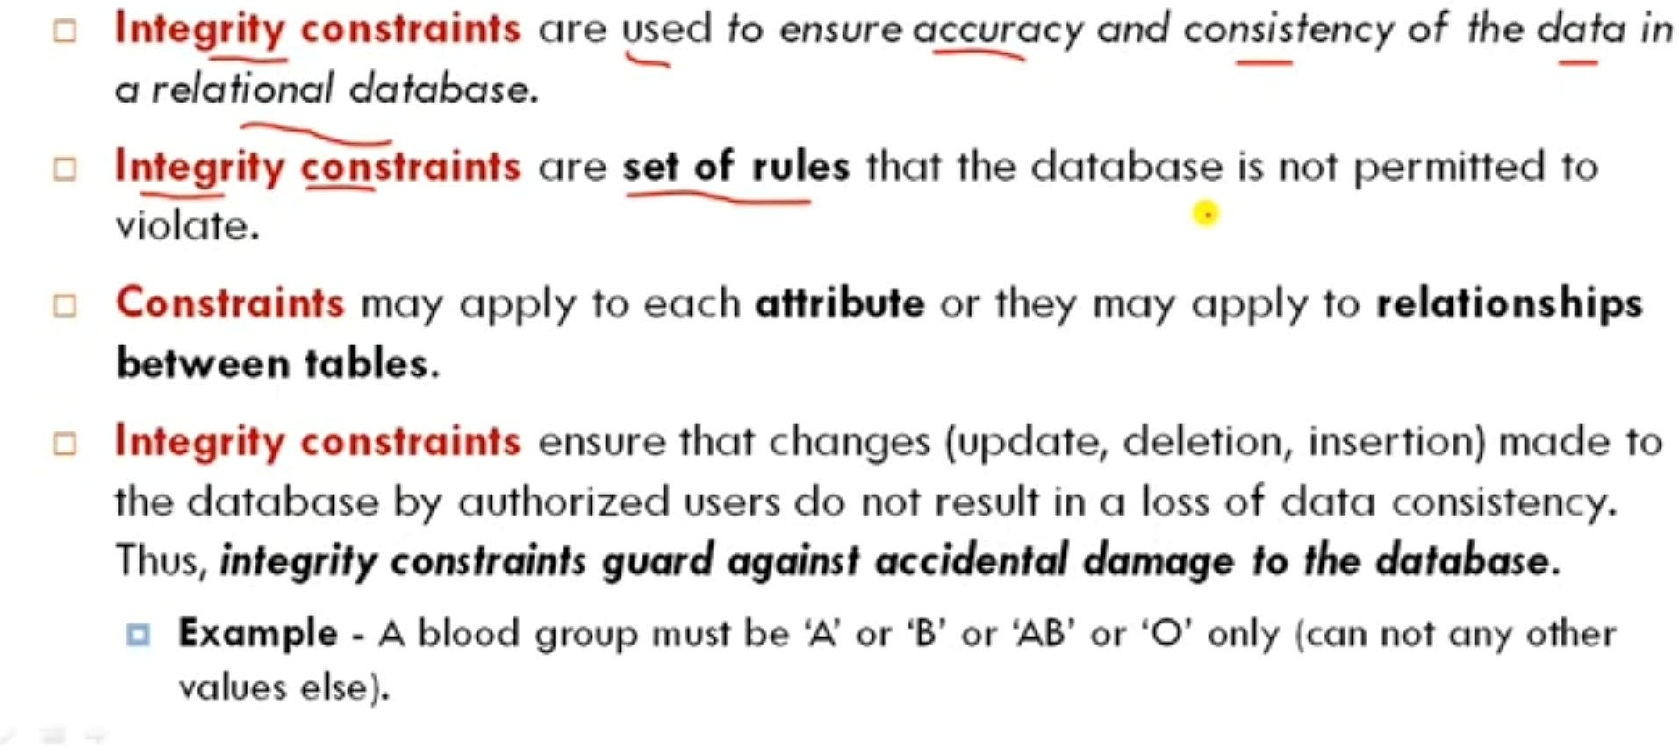
INTEGRITY CONSTRAINTS

Slide 40
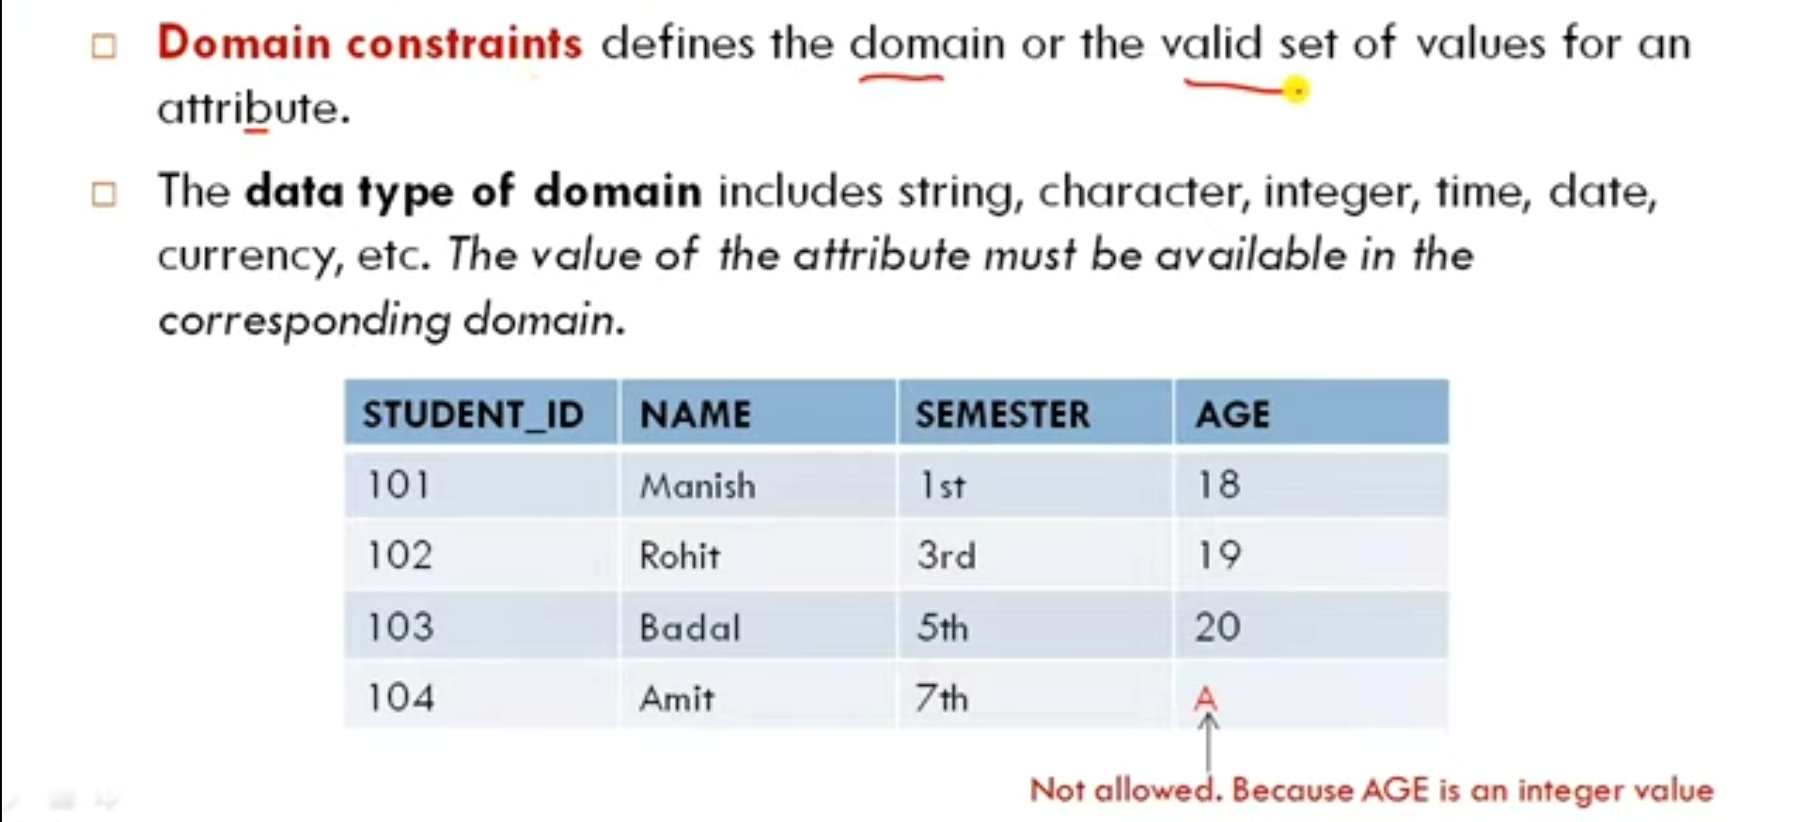
Domain Integrity Constraints

Slide 41
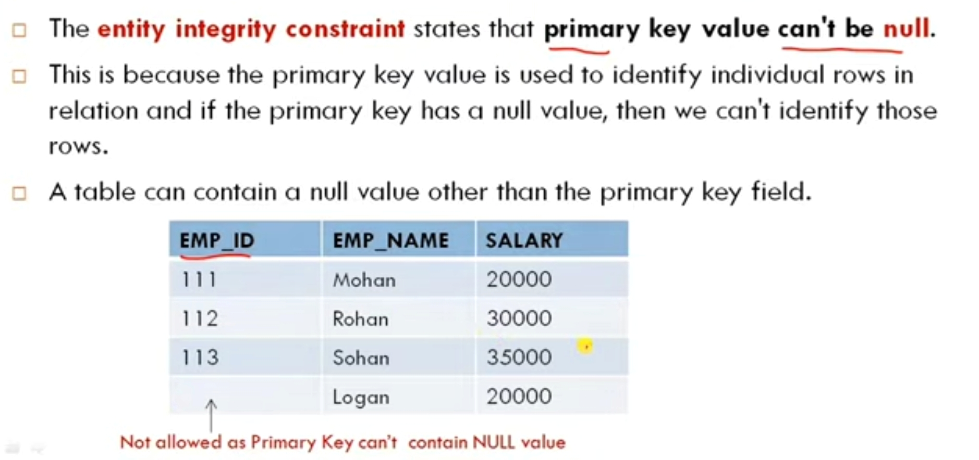
Entity Integrity Constraints

Slide 42
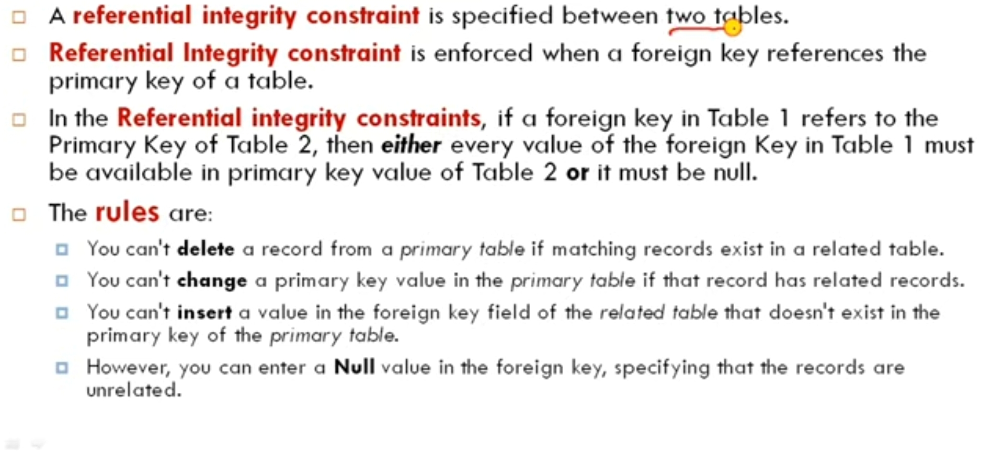
Referential Integrity Constraints

Slide 43
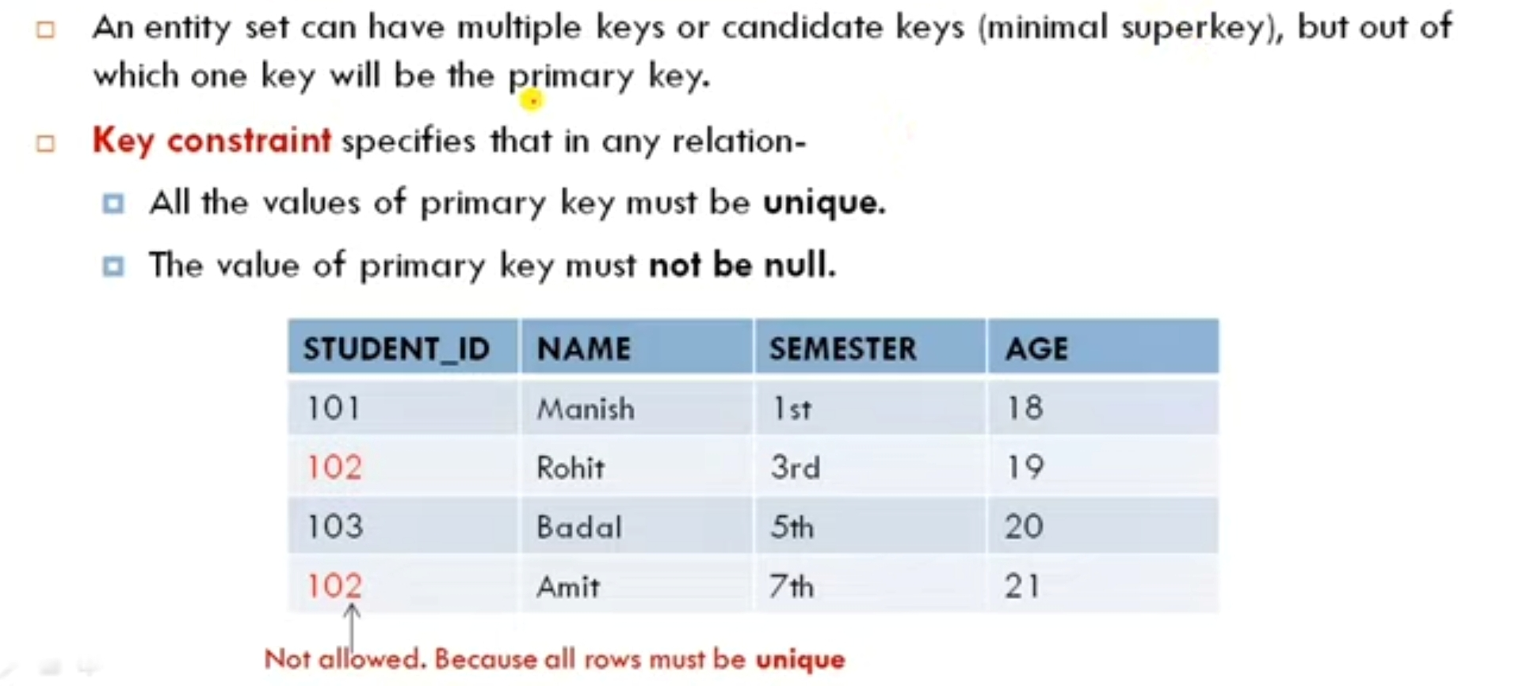
Key Constraints

Slide 44
Enforcing Integrity Constraints
There are several ways to enforce integrity constraints in a DBMS:
Declarative referential integrity: This method involves specifying the integrity constraints at the time of database design and allowing the DBMS to enforce them automatically.
Triggers: A trigger is a special type of stored procedure that is executed automatically by the DBMS when certain events occur (such as inserting, updating, or deleting data). Triggers can be used to enforce integrity constraints by checking for and rejecting invalid data.
Stored procedures: A stored procedure is a pre-defined set of SQL statements that can be executed as a single unit. Stored procedures can be used to enforce integrity constraints by performing checks on the data before it is inserted, updated, or deleted.
Application-level code: Integrity constraints can also be enforced at the application level by writing code to check for and reject invalid data before it is entered into the database.

Slide 45
Querying Relational Data : A relational database query is a question about the data, and the answer consists of a new relation containing the result. A query language is a special language for writing queries. SQL is most popular commercial query language for a relational DBMS.
For example : Find all the employee whose salary is more that 25,000/-
SELECT * FROM employee E WHERE E.salary > 25000;
In the above query, ‘*’ means that we retain all fields of selected tuples in the result. E is a variable that takes on the value of each tuple in Employee, one tuple after the other. The condition E.salary>25000 in the WHERE clause specifies that we want to select only tuples in which the salary filed has a value greater than 25000\-.

